Slide 1
welcome
To the PRESENTATION

Slide 2


Slide 3





INTRODUCTION
ABSTRACT
CRIME DATA
ANALYSIS
REQUIREMENTS
CONCLUSION

Slide 4

EXISTING
PROPOSED
Physical Evidence
Collection
Electronical
surveillance
CRIME DETECTION
TECHNIQUES
Under Cover Agents
Suspect Identification
Laboratory Analysis
Finding the
Root Causes

Slide 5
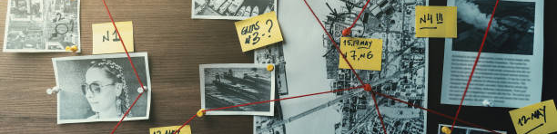
Crime data analysis
ABSTRACT
The Primary Objective of this "Crime Data Analysis" is to collecting the crimes Data From different sources like articles, old newspapers.
The crime data analysis presentation provides a comprehensive overview of the key points and findings derived from analyzing crime data.
The analysis aims to identify patterns , strategies, trends, and insights that can inform law enforcement and policies.
Revealing the insights through data

Slide 6


Slide 7

Crime data analysis
Software Requirements :
* Accurate Search engine (google)
* Microsoft Office Applications
(word, Excel , PowerPoint)
* Applications to access to Binary Files
Revealing the insights through data

Slide 8

Crime data analysis
Hardware Requirements :
A Personal Computer / Laptop with RAM
(8 GB ) ROM (512 GB ) Processor (Intel/Ryzen )
2. Good internet Connection Facility
Revealing the insights through data

Slide 9



Conclusion :
By Using the Proposed Techniques we can see that :
Crime rates have been steadily decreased Compared to Past Years.
The highest crime rates are observed in urban areas,
particularly in low-income neighborhoods.
Detection of the suspects may Little Easy compared to past Years .

Slide 10

SPECIAL THANKS TO :
Ms . P. Bushra Anjum Mam
HAVE A NICE DAY ☺ ☺

